Slide 1
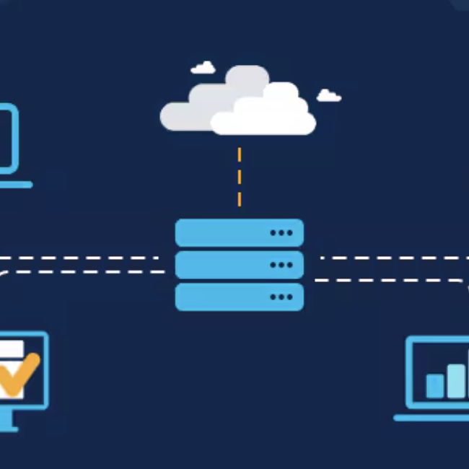
WDTC INC. NETWORK design
Logan chayet
Ashwin chandrasekharan
Sneha irukuvajjula

Slide 2
OVERVIEW
WDTC Inc., a Tier 2 ISP is planning to expand its footprint in the central US with a new site in Denver, Colorado. It already has offices in Las Vegas, Los Angeles, and Phoenix.
Design a cost-efficient, highly available and fault-tolerant backbone, datacenter and VoIP network while ensuring security and scalability.
Our proposal aims to win the implementation contract by presenting a solution that not only meets technical requirements but also aligns with the company's financial objectives.

Slide 3
Our solution
Fault-tolerant
Highly available
Scalable
Cloud Integration
CLOS Topology
Low latency for VoIP calls
SDN for Tier 3 ISPs

Slide 4
budget
We offer multiple packages and we let you choose what works the best for your organization.
"Total Solution" Package
Designing, deployment, testing, troubleshooting
After-sales services like maintaining and supporting
Bill of materials
"Design & Deploy" package
Designing, deploying, testing and troubleshooting
Bill of materials

Slide 5

"Total solution package"
Unit | Quantity | Price (per year)
Backbone
SFP-10G-10AOC SFP+ 10G direct attach active optical cable, 10m length | 16 | $60
1m (3ft) Generic Compatible 100G QSFP28 Active Optical Cable | 4 | $169
Juniper MX204 Universal Routing Platform (Edge) | 4 | $24,000
Meraki MS425-32 | 6 | $18,000
QSFP-100G-SR4-S Compatible QSFP28 100GBASE-SR4 850nm 100m DOM MPO-12/UPC MMF Optical Transceiver Module | 4 | $100
SFP-10G-SR Compatible SFP+ 10GBASE-SR 850nm 300m DOM Duplex LC/UPC MMF Optical Transceiver Module | 32 | $20
Datacenter
AWS EC2 (t3.medium) | 50 | $12,960
AWS EBS (gp3): About 15 TB total storage | 2 | $14,745.60
AWS ELB | 1 | $217.68
AWS Transit Gateway (per TB of data transfer) | 1 | $7,372.80
AWS Global Accelerator (per TB of data transfer) | 1 | $184.32
AWS CloudWatch | 1 | $1,260
VoIP
Simultaneuos calls | 48 | $1,795
IP Phones | 50 | $1,447.50
Amazon Chimes
Backbone OpEx (yearly)
Meraki MS425-32 Licensing | 6 | $1,020
Juniper MX204 Universal Routing Platform (Edge) | 4 | $3,000
Total Solutions Package* |  | 130,000
Total |  | 216,352
*This covers the costs for design, deployment, and maintenance. To sustain support in the following years, the annual fee is $60,000.

Slide 6
"Design and deploy" package
Unit | Quantity | Price (per year)
Backbone
SFP-10G-10AOC SFP+ 10G direct attach active optical cable, 10m length | 16 | $60
1m (3ft) Generic Compatible 100G QSFP28 Active Optical Cable | 4 | $169
Juniper MX204 Universal Routing Platform (Edge) | 4 | $24,000
Meraki MS425-32 | 6 | $18,000
QSFP-100G-SR4-S Compatible QSFP28 100GBASE-SR4 850nm 100m DOM MPO-12/UPC MMF Optical Transceiver Module | 4 | $100
SFP-10G-SR Compatible SFP+ 10GBASE-SR 850nm 300m DOM Duplex LC/UPC MMF Optical Transceiver Module | 32 | $20
Datacenter
AWS EC2 (t3.medium) | 50 | $12,960
AWS EBS (gp3): About 15 TB total storage | 2 | $14,745.60
AWS ELB | 1 | $217.68
AWS Transit Gateway (per TB of data transfer) | 1 | $7,372.80
AWS Global Accelerator (per TB of data transfer) | 1 | $184.32
AWS CloudWatch | 1 | $1,260
VoIP
Simultaneuos calls | 48 | $1,795
IP Phones | 50 | $1,447.50
Amazon Chimes
Backbone OpEx (yearly)
Meraki MS425-32 Licensing | 6 | $1,020
Juniper MX204 Universal Routing Platform (Edge) | 4 | $3,000
Design & Deploy Package |  | 90,000
Total |  | 176,352

Slide 7
TIMELINE
Hardware delivery – 6 months
Phase 1 (Pre-deployment) - 8 weeks
Phase 2 (Deployment in production) - 3 weeks
Phase 3 (Testing and troubleshooting) - 2 weeks
Total Delivery Timeline: 10 months
*While awaiting hardware delivery, we will concurrently progress with the deployment of Datacenter and VoIP. The estimated time for the complete AWS setup is anticipated to be 3 months.

Slide 8
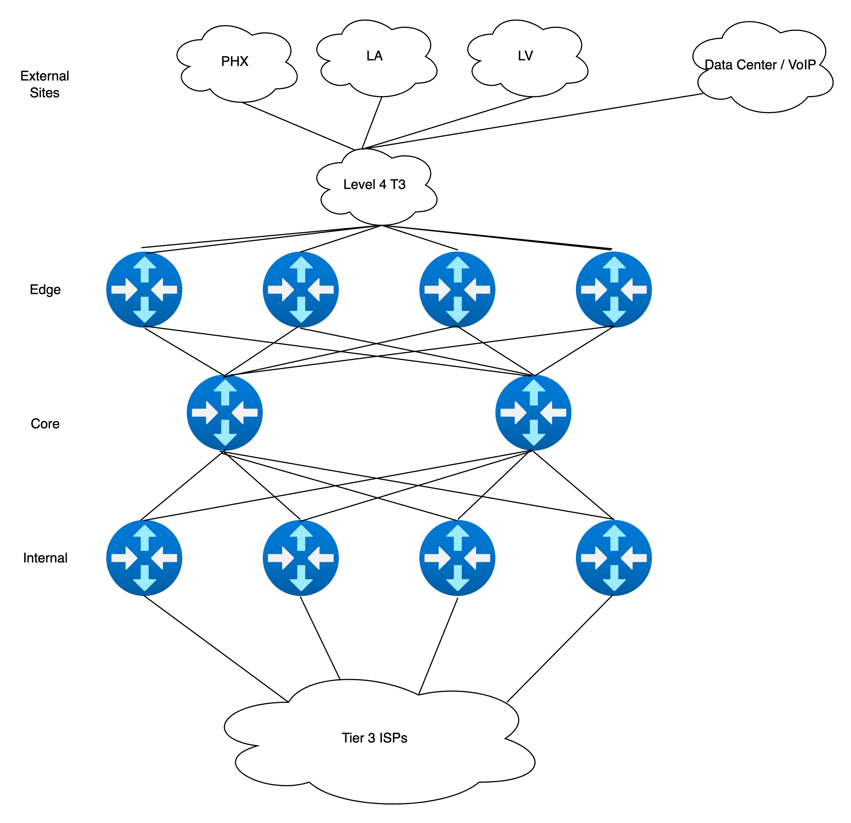
BACKBONE NETWORK DESIGN

Slide 9
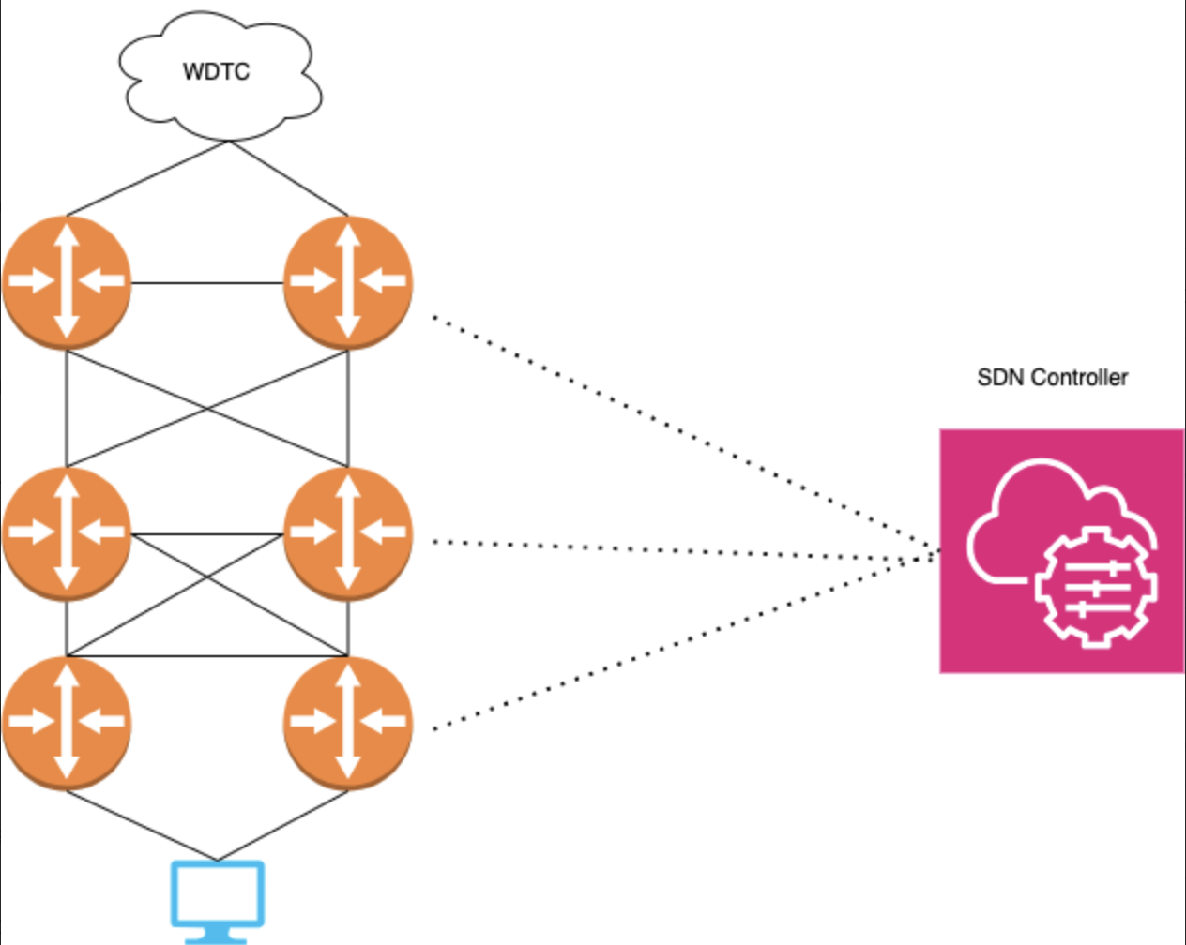
SDN for Tier 3 ISPs

Slide 10
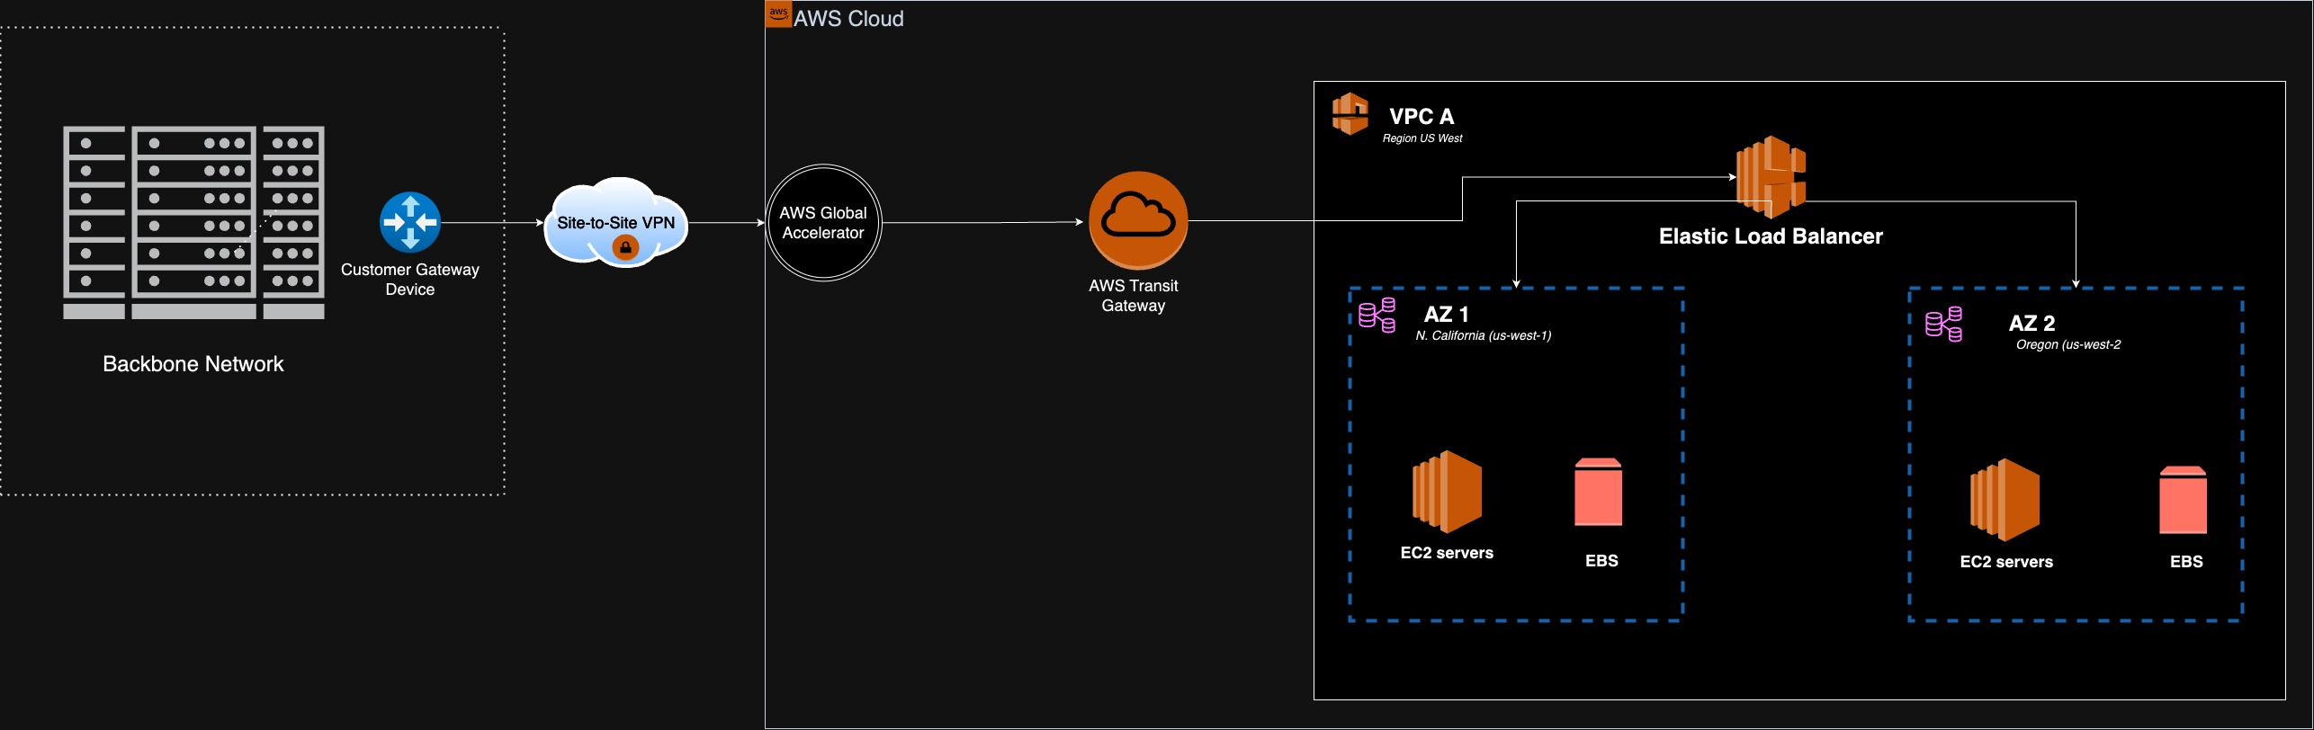
DATACENTER NETWORK DESIGN

Slide 11
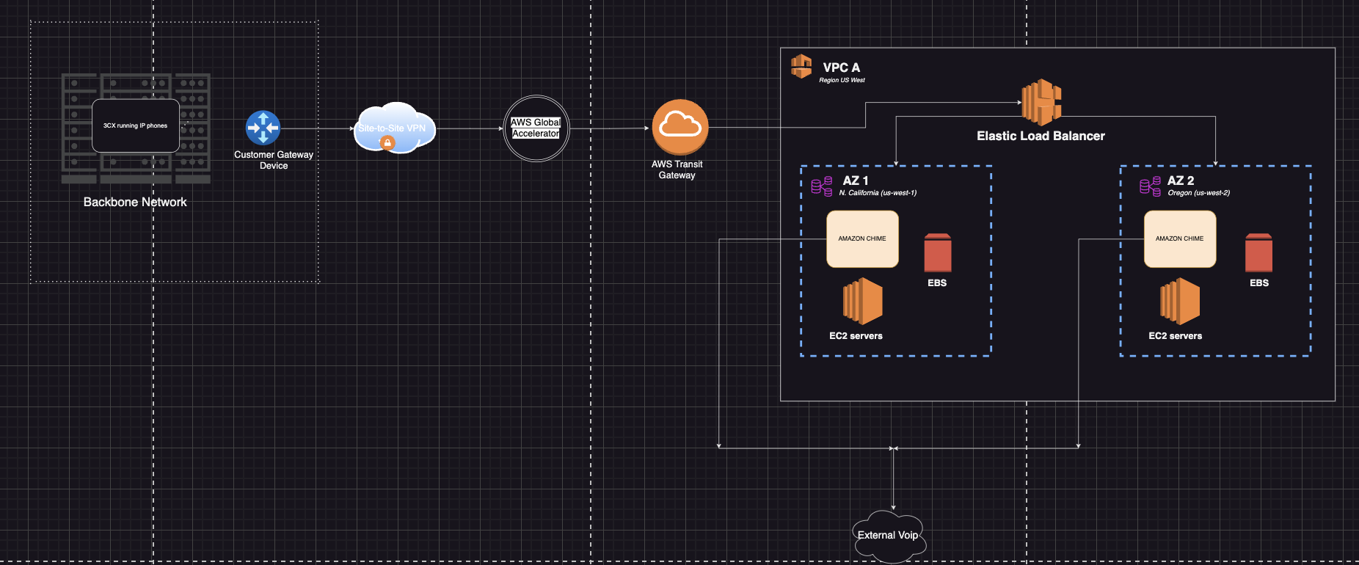
VOip nETWORK DESIGN

Slide 12
WHY CHOOSE US?

